Slide 1

Retail Competitive Analysis Tool
Project Proposal
Alicia Alarie

Slide 2
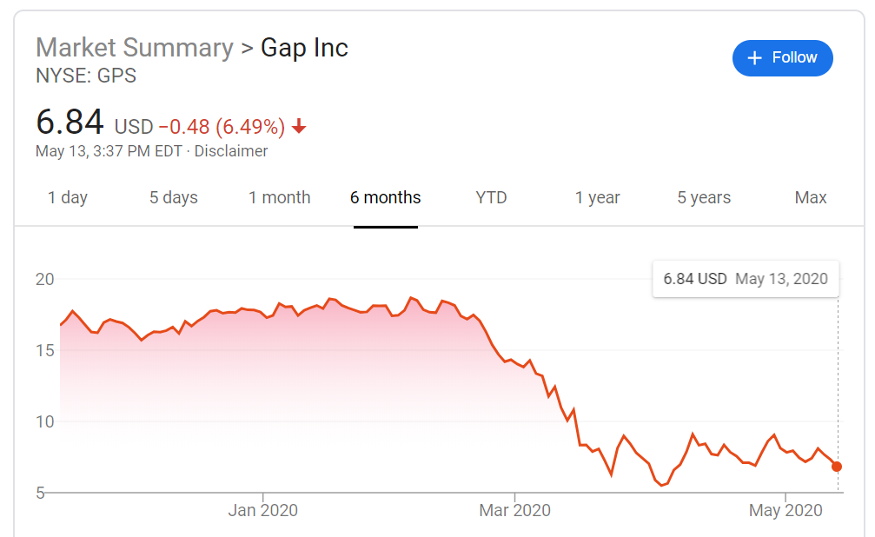
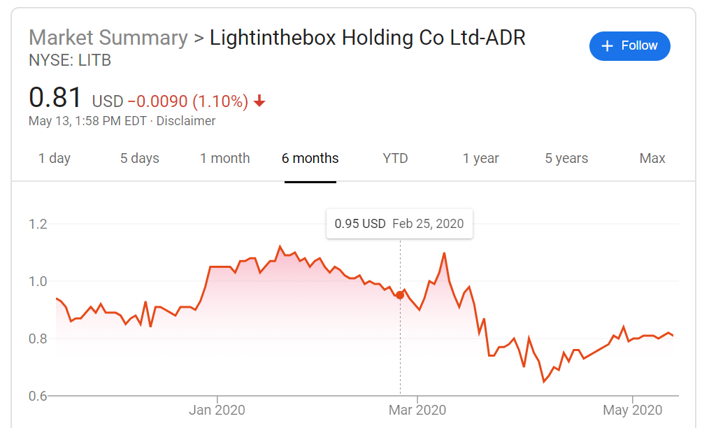
Motivation
“The ability to learn faster than your competitors is maybe the only sustainable competitive advantage.” – Arie De Geus, Business Theorist & Head of Shell Oil’s Strategic Planning Group
Businesses may be unsure of how the market is changing to do technology trends or global events
They may have increasing competition and no visibility into how they stack up
They have too much data and not enough time to analyze effectively
Covid-19 Effects

Slide 3
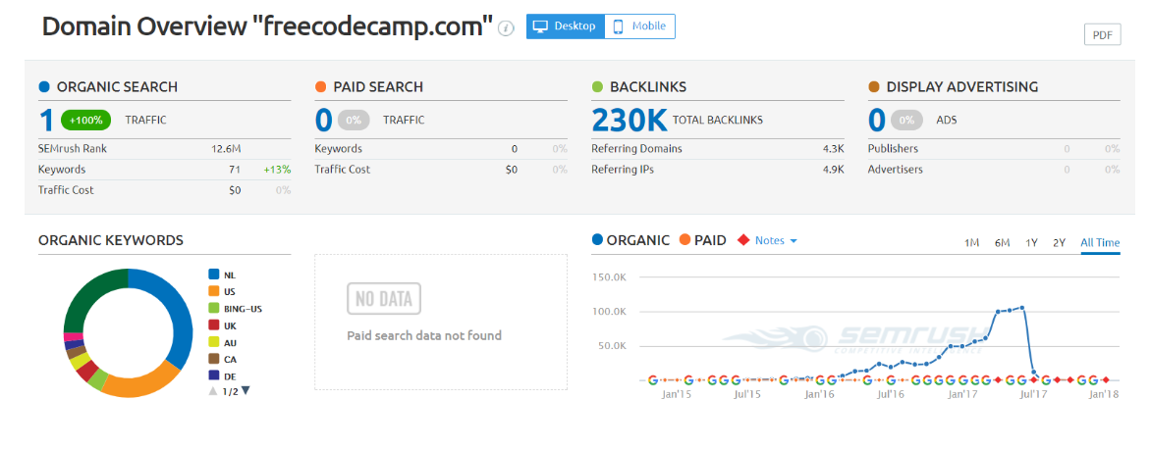
Project Goals
Many existing solutions are too general and focus on website traffic and search keywords
  Get an overview of another company’s place in the market/competitor space based on inventory information
  Use scraped data in conjunction with annual reports to predict company’s health
  Scrape daily to produce fine grain fluctuations in prices/ price tracking

Slide 4
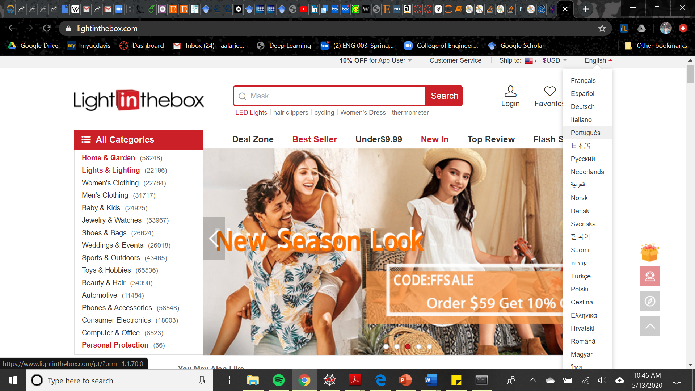



The Data
The data was scraped using a web scraper to parse HTML and JSON, and is stored in an SQLite database.

Slide 5
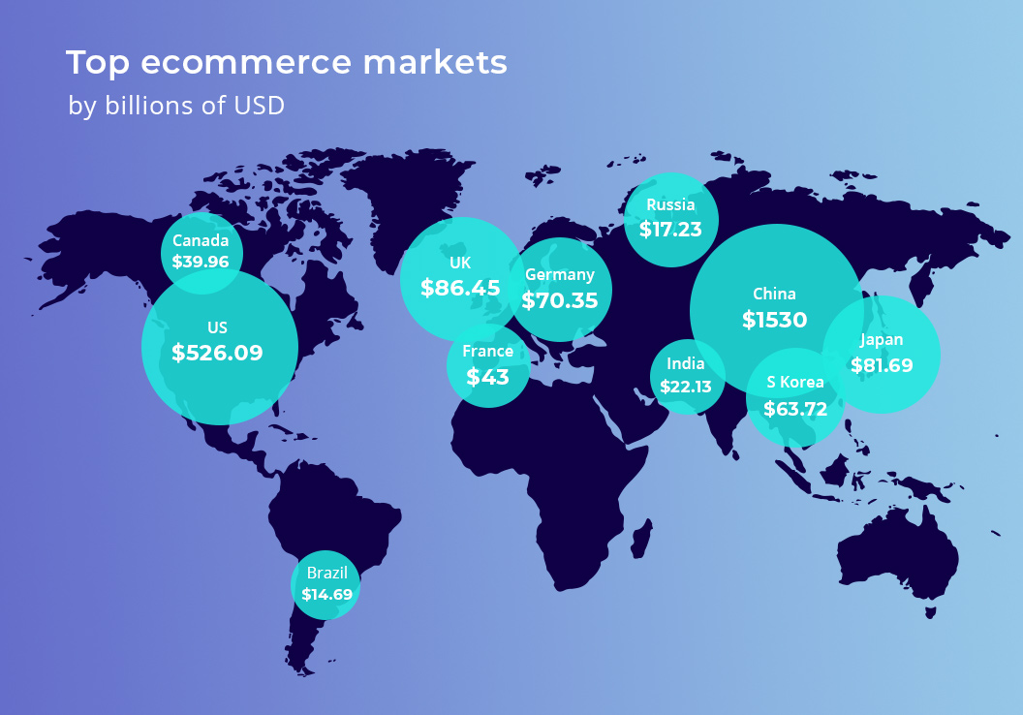
The Data
* From Shopify and Statista
The LightInTheBox Holding Co., Ltd. takes in ~240 million in revenue annually, delivers products to consumers in over 200 countries, and has websites which are available in 26 major languages according to the company's website.

Slide 6
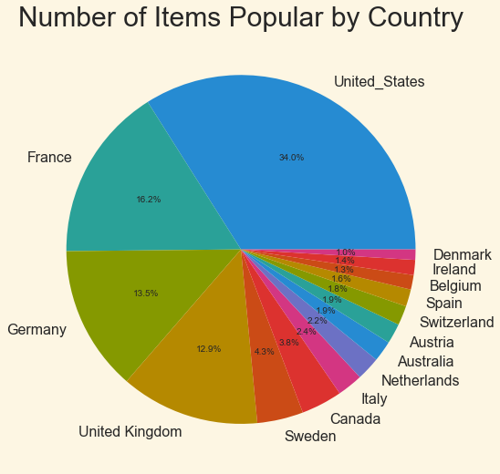
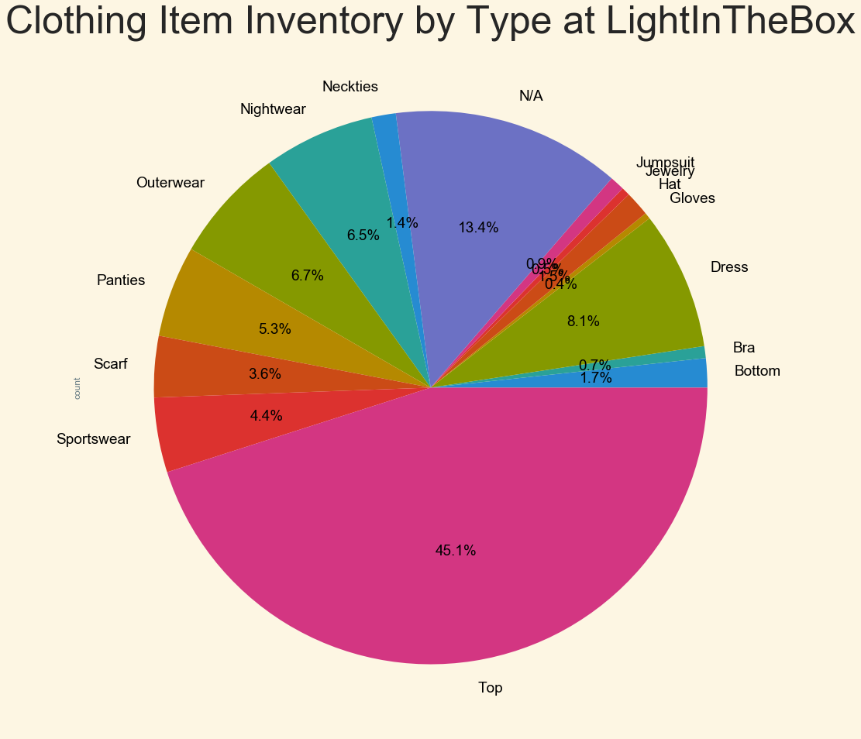
Data Exploration

Slide 7
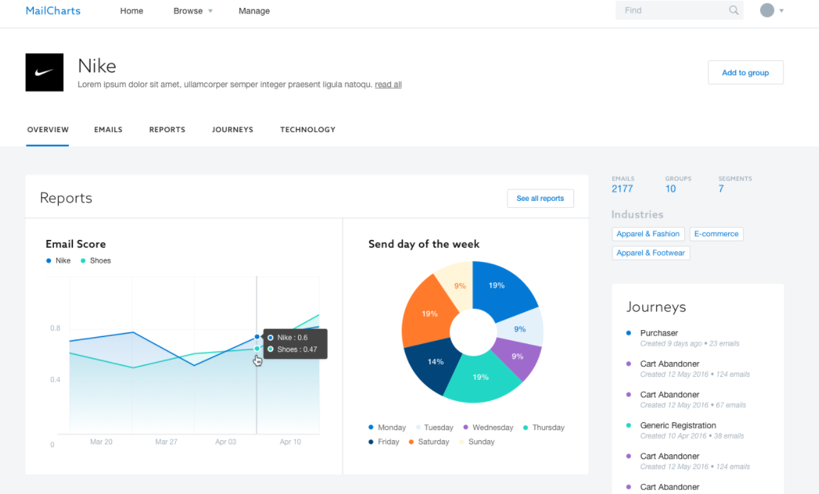


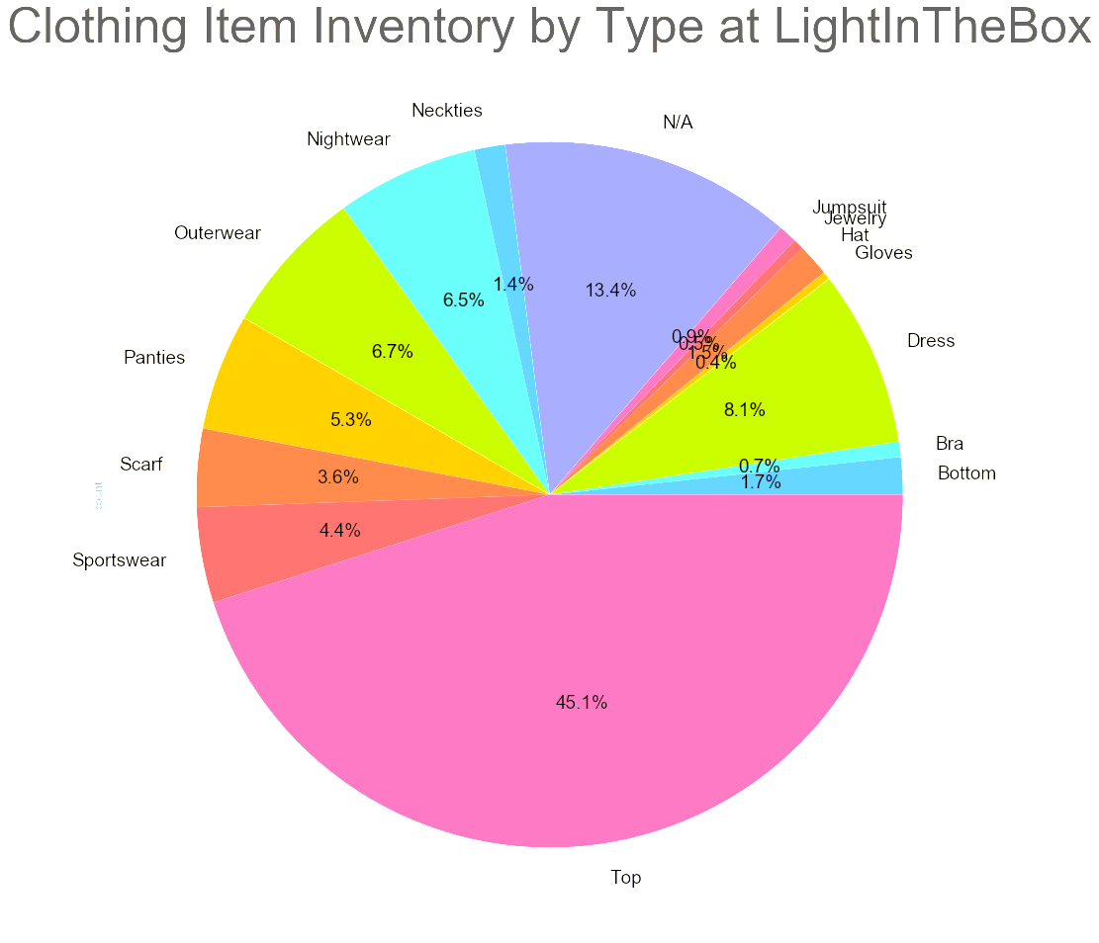
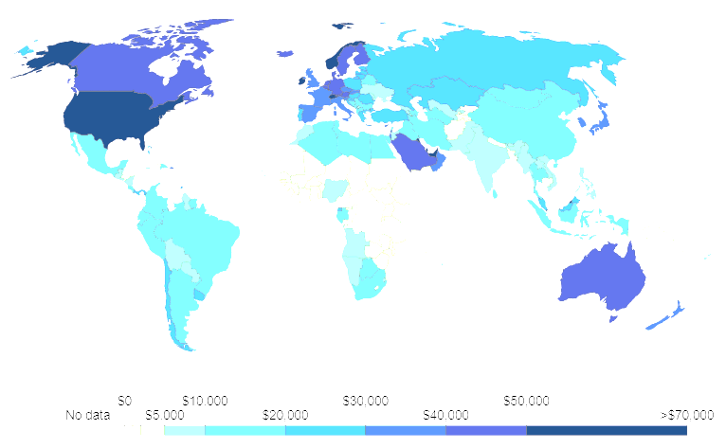
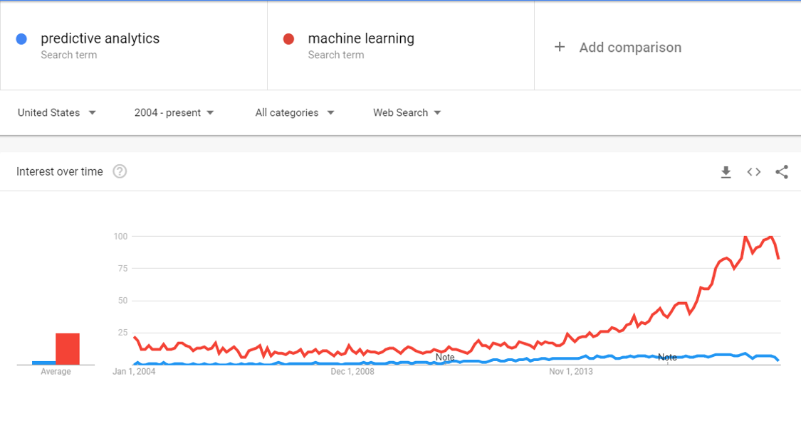
Future Work
Popular Regions
Sales Predictions

